Slide 1
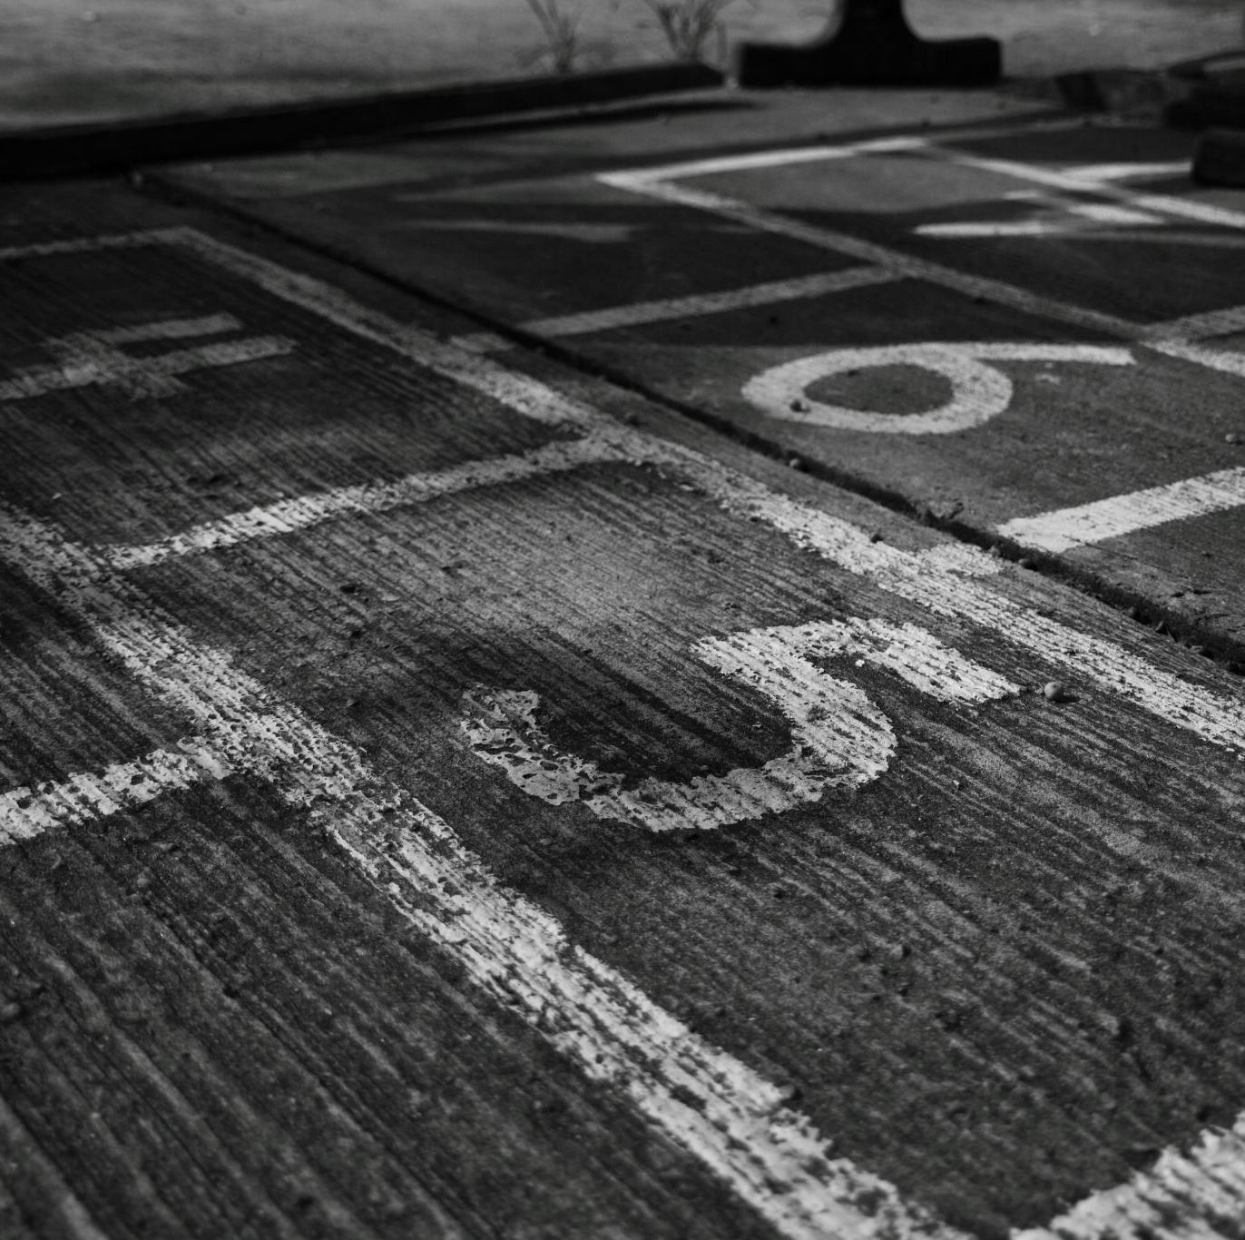
Week 4: Zeroes, identifiability and searching
Ryan Ka Yau Lai
University of California, Santa Barbara

Slide 2

Before we start …
Open sbc007.rez
If you have a file saved from last week’s section + show, please open that
If not, just open sbc007

Slide 3
Today’s question
Give a real-life example of a definite referring expression from any source (SBC002/007, your daily life, media …) and comment on why a definite expression was chosen.

Slide 4
Accessibility once more
Shorter distance from previous mention (track)
Shorter referential expression
Higher accessibility
Larger number of previous mentions (farther along in trail)
Less specific referential expression
…
How short can we get?

Slide 5
Accessibility hierarchy
Full noun phrases
Noun phrase with relative clause: The person who stole the watch
Proper name: Mary
Pronouns
Demonstrative pronoun: That, these
?
Can we go smaller?
Noun phrase with adjective: The funny person
Personal pronoun: She, it
Increasing accessibility

Slide 6
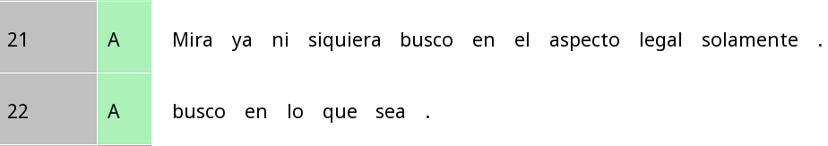
Verb morphology as person marking
look already not even look-1sg in the aspect legal only
Look (I) am not even looking just in the legal aspect.
look-1sg in that which be-SUBJUNC
(I) am looking everywhere.
How many referential expressions?

Slide 7
Verb morphology as person marking
Look (I) am not even looking just in the legal aspect.
(I) am looking everywhere.
Person | Verb form
1 | Busc-o
2 | Busc-as
3 | Busc-a

Slide 8
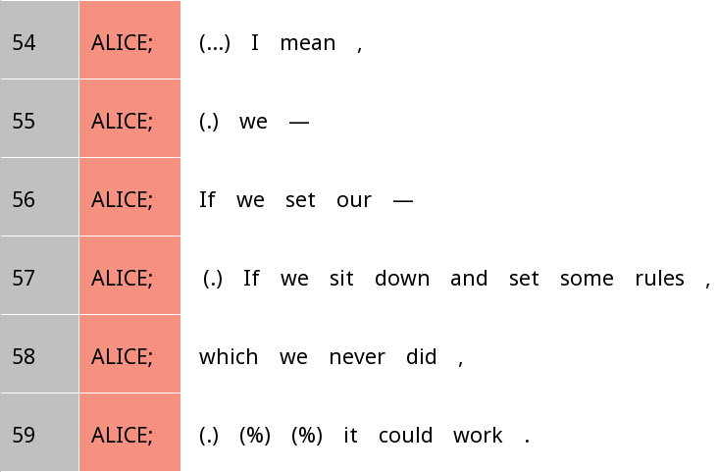
How about English?
Who is setting rules here?

Slide 9
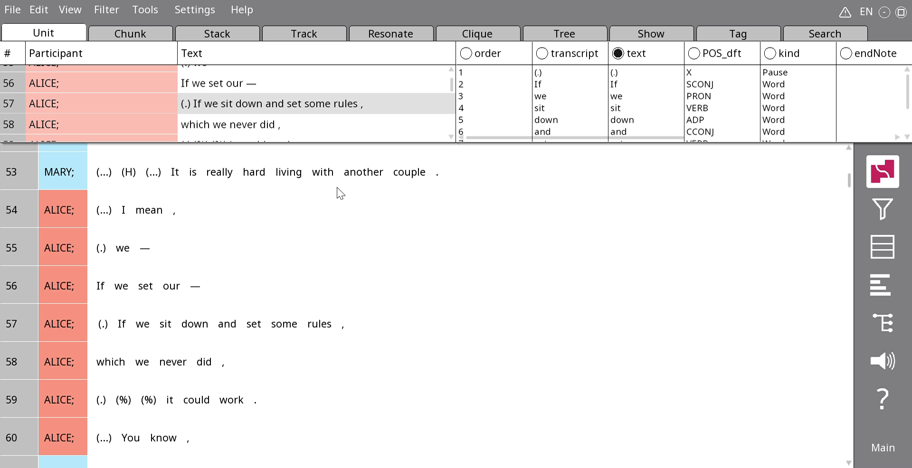
Inserting zeros in Rezonator
Note: We typically insert a zero where a pronoun might have appeared

Slide 10
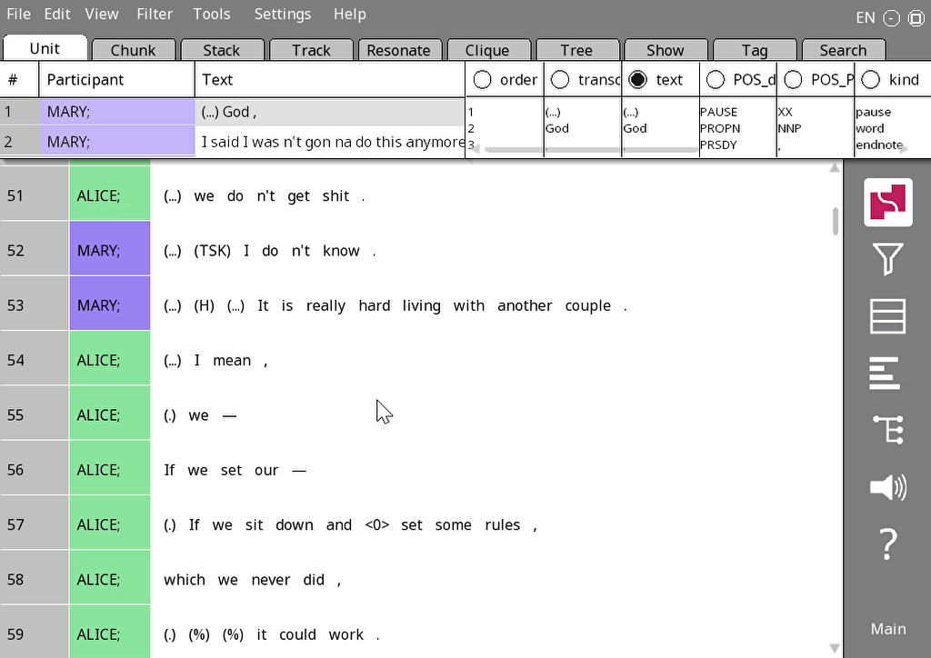
Side links
If you want to put two tracks on the same line, Rezonator will ask if you’re sure.
Just press OK if asked!

Slide 11
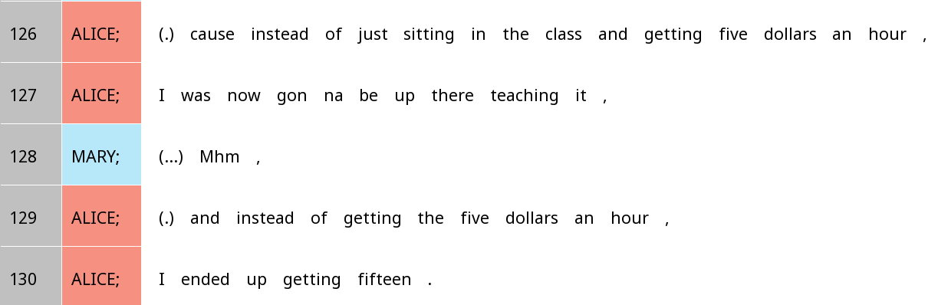
Spot the zeros

Slide 12
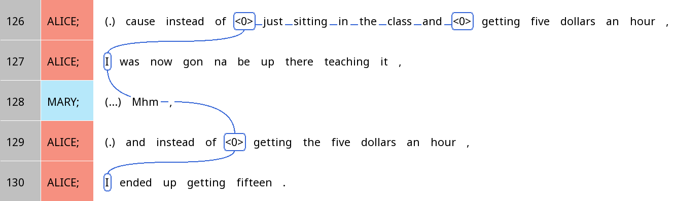
Cataphora
A lighter referring expression points to a following, heavier referring expression

Slide 13

Spotting zeroes
When you see a verb, ask yourself: Is there someone or something you can infer as being involved in this event/state that is not explicitly mentioned?

Slide 14

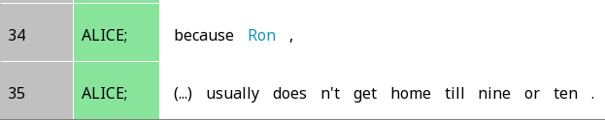
Warning!
Sometimes subjects can appear on a different unit than the verb.
In this case, we don’t consider there being a zero!

Slide 15
Your turn!
Find one example of a zero in SBC007 that we haven’t discussed
Create a coreference chain, including all mentions of the same referent within ten IUs (i.e. if the zero is on line 20, do lines 10-30)
Tell your partner a) why you think the speaker did not mention the referent specifically, and b) how you think the listener might figure out the referent
Bonus: Why did the speaker not use a zero in other cases?

Slide 16
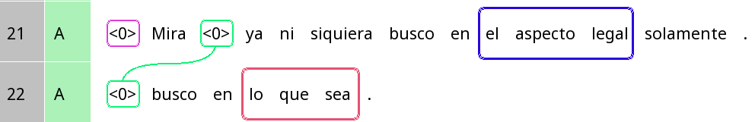


Studying pronoun absence in Spanish
These are not ‘true’ zeroes since the actual referential expressions are on the verb!
But we mark them as zeroes anyways (since the suffix is not a separate token in these texts
look already not even look-1sg in the aspect legal only
Look (I) am not even looking just in the legal aspect.
look-1sg in that which be-SUBJUNC
(I) am looking in whatever.

Slide 17
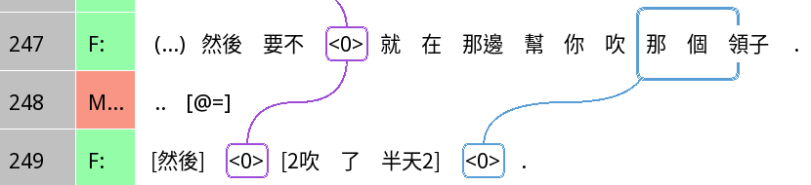
Studying zeroes in Chinese
The ‘he’ is a barber (mentioned in previous context)
Important: Zeroes not limited to ‘subjects’ but also ‘objects’
then otherwise then at that.side help you blow that CLF collar
Then, otherwise, (he) was there helping you blow that collar
then blow PFV half.day
Then (he) blew (it) for half a day (i.e. a long time).

Slide 18
Identifiability vs accessibility
Identifiability
Accessibility
Can I locate that referent among the set of entities I have identities for?
>> Linguistic expression: Definiteness vs indefiniteness
How easy is it for me to think of that thing?
>> Linguistic expression: Longer/more detailed vs shorter/less detailed forms

Slide 19
Identifiability vs definiteness
Identifiability
Definiteness
Can I locate that referent among the set of entities I have identities for?
What did I use to communicate (non-)identifiability?
Definite: the X, that X, it, Mary …
Indefinite: a(n) X, any X, someone …

Slide 20
Definiteness in Spanish and Mandarin
Spanish
Mandarin
Definite: la/el X, ella/él, le, este/esta X, María …
Indefinite: un(a), uno, alguno X, alguien …
Definite: 這(一)個/那(一)個 X, 張三, 他
Indefinite: 一個/兩個 X, 有 construction
Referring expressions in Mandarin are very often neither definite nor indefinite!

Slide 21
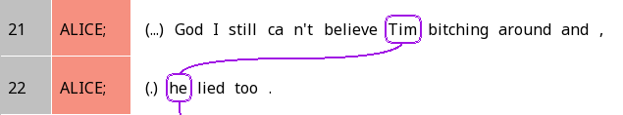
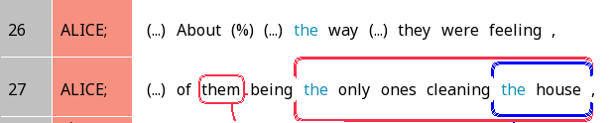
Some identifiable cases

Slide 22
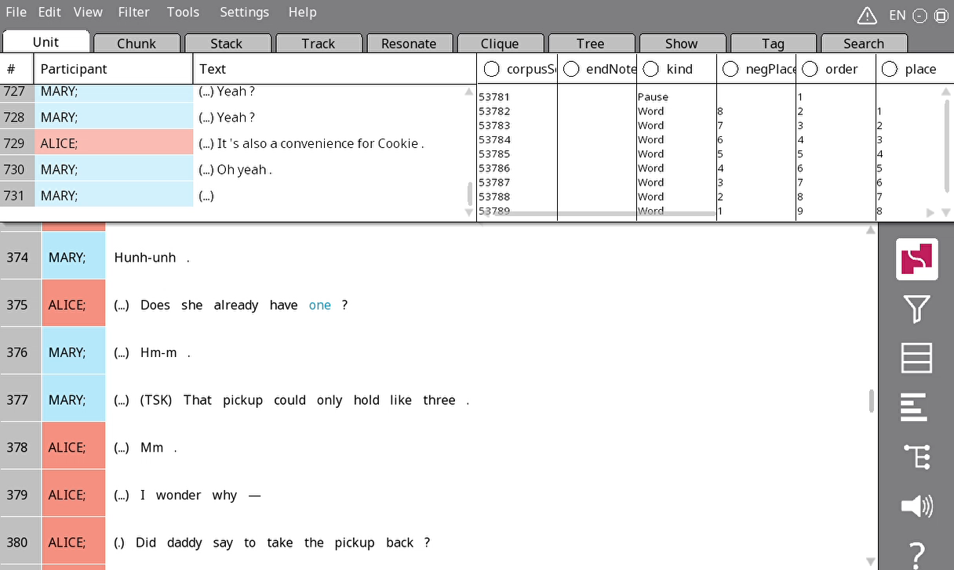
Jumping to a line in Rezonator
Press G
Enter line number
Press OK
Can you go to Line 123?

Slide 23
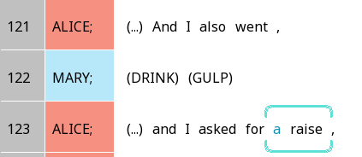
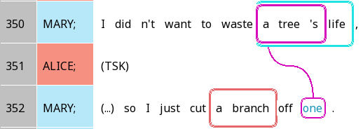
Some non-identifiable cases

Slide 24
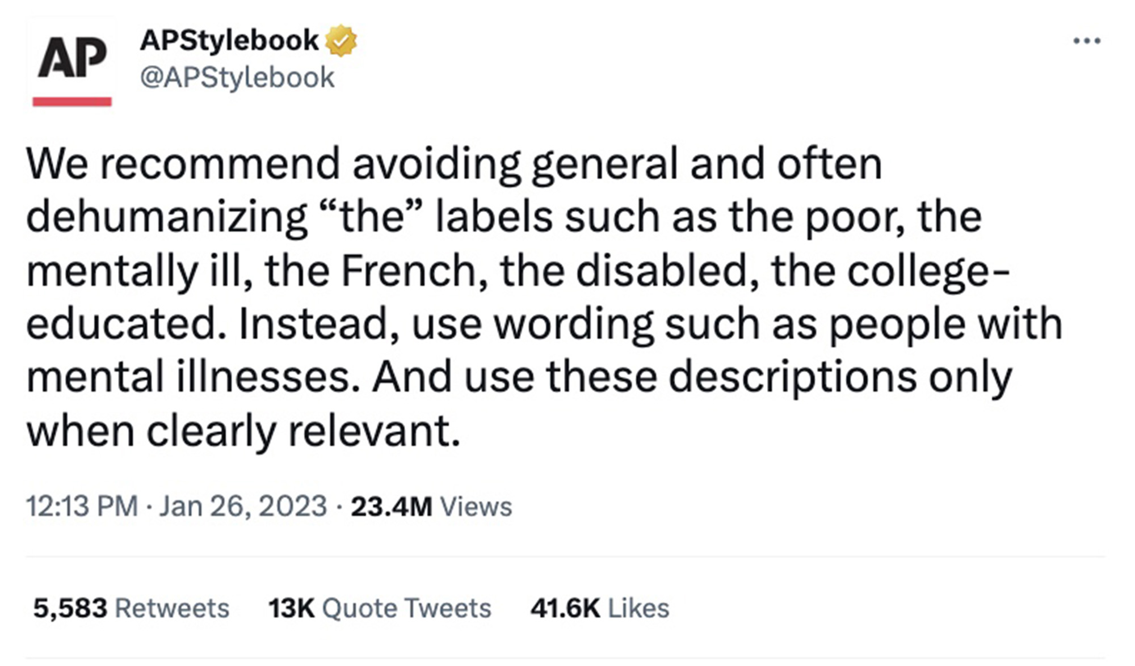
Some Internet news you might have heard …

Slide 25
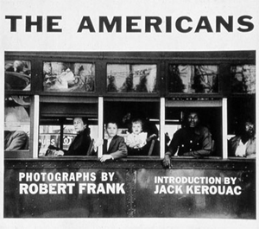
But there might be a kernel of truth behind it …

Slide 26
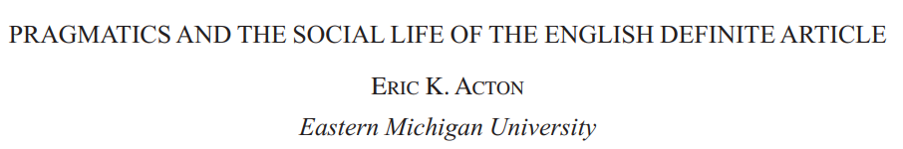

Non-identifiable
‘Americans like cars.’
Indefinite: Conveys non-identifiability
‘I’m giving a statement that gives a general characterisation of Americans, not specifying any particular Americans’

Slide 27
Identifiable
‘The Americans like cars.’
Indefinite: Conveys identifiability
‘I’m treating the Americans as a group with hard boundaries’
> Distancing, homogenising

Slide 28
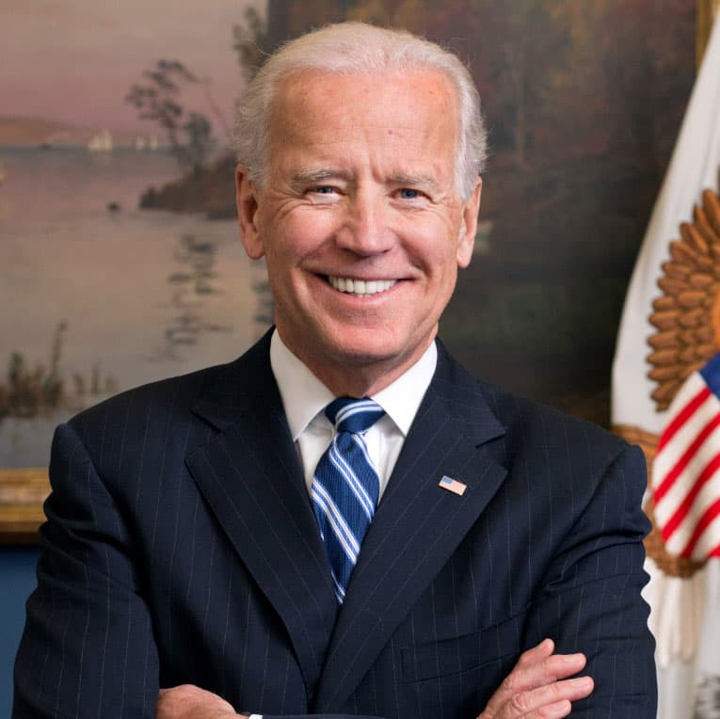
… but not always.
the American people are going to emerge from this moment stronger, more determined, and better equipped to unite the world in fighting to defend democracy
Though definite forms can sometimes be distancing, sometimes they can also show unity and solidarity!

Slide 29
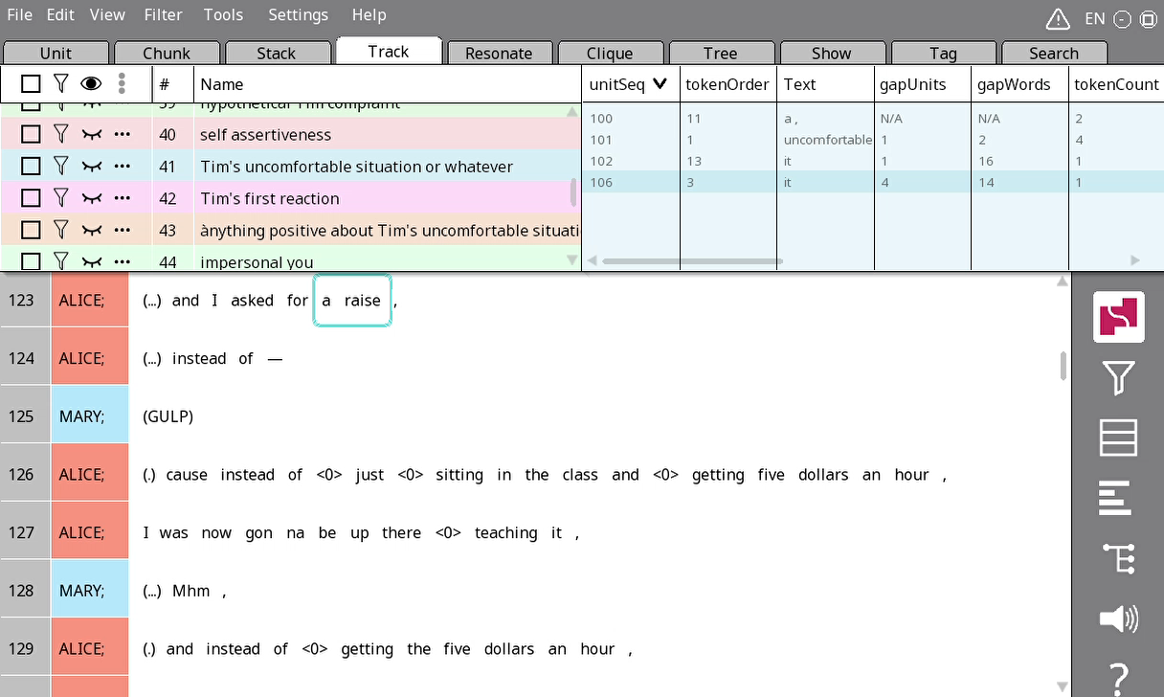
Searching
Go to the Search tab
Click on the green + line
Select a search field; for today, just leave it as Text
Click OK

Slide 30
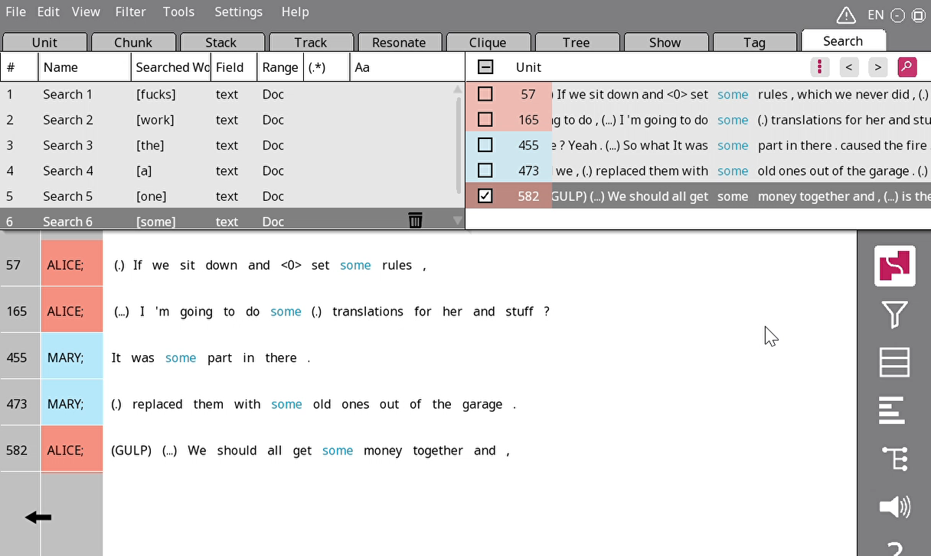
Sifting through search results
Click on the magnifying glass in the corner
On the right side of the nav window, click on a line that looks interesting
The main screen should now show the context of that example

Slide 31

Your turn!
Search for a token that indicates definiteness (e.g. the, that, she) or indefiniteness (some, any, a)
Choose one referring expression that looks interesting
Add that referring expression to a trail
Look for surrounding referring expressions about the same referent and add them to the trail too
Think about:
Is that referent identifiable?
Why did the speaker choose to use a definite or indefinite referring expression?

